Slide 1
Class Diagram and Sequence Diagram
Lecture-6
AKM iqtidar Newaz [IqN]
Lecture - 6

Slide 2
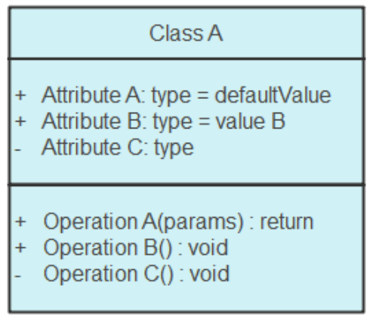
Class Diagram
What is a Class Diagram?
A class diagram is a static structure that is used in software engineering. A class diagram shows the classes, attributes, operations, and the relationship between them. This helps software engineers in developing the code for an application.
Basic Components of Class Diagram:
Upper section: Contains the name of the class.
Middle section: Contains the attributes of the class.
Bottom section: Includes class operations (methods).
Displayed in list format, each operation takes up its own line.

Slide 3
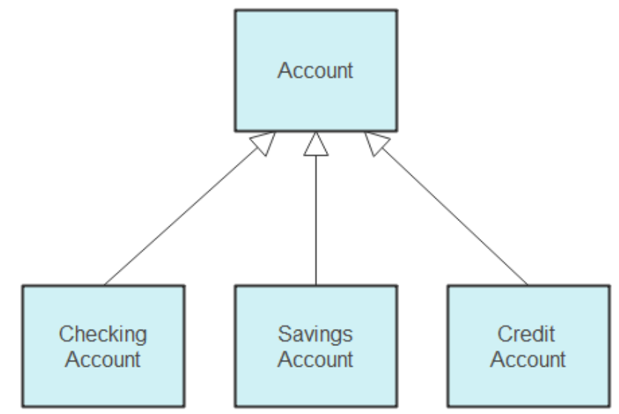
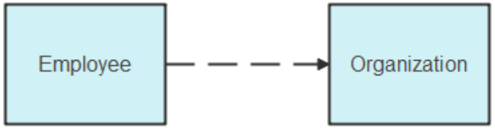
Class Interactions
Member access modifiers
All classes have different access levels depending on the access modifier (visibility). Here are the access levels with their corresponding symbols:
Public (+)
Private (-)
Protected (#)
Package (~)
Static (underlined)
Interactions between classes:
Inheritance: The process of a child or sub-class taking on the functionality of
a parent or superclass, also known as generalization.
Dependencies: Dependency shows that one class depends on another. Change in one class will create change in another class. For example, an employee is dependent on the organization.

Slide 4
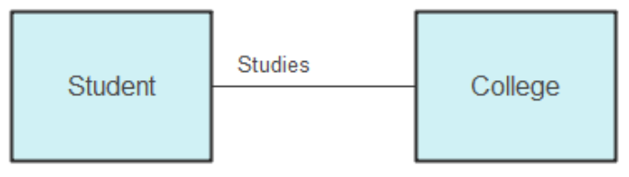
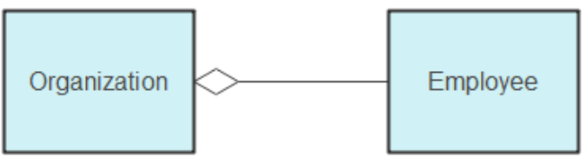
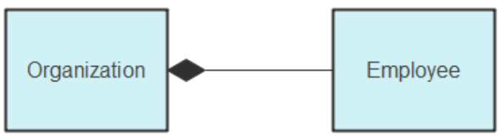
Class Interactions
Association: Association shows a static relationship between two entities. The association between a student and school is “studies”.
Aggregation: In aggregation, 2 classes have a whole-part relationship. For example, if an employee does not come, the organization will remain there.
The aggregation has another special type, called composition. In composition, a class is strongly connected to another class that it will stop functioning without it. For example, if an organization closes, all employees will have to leave.

Slide 5
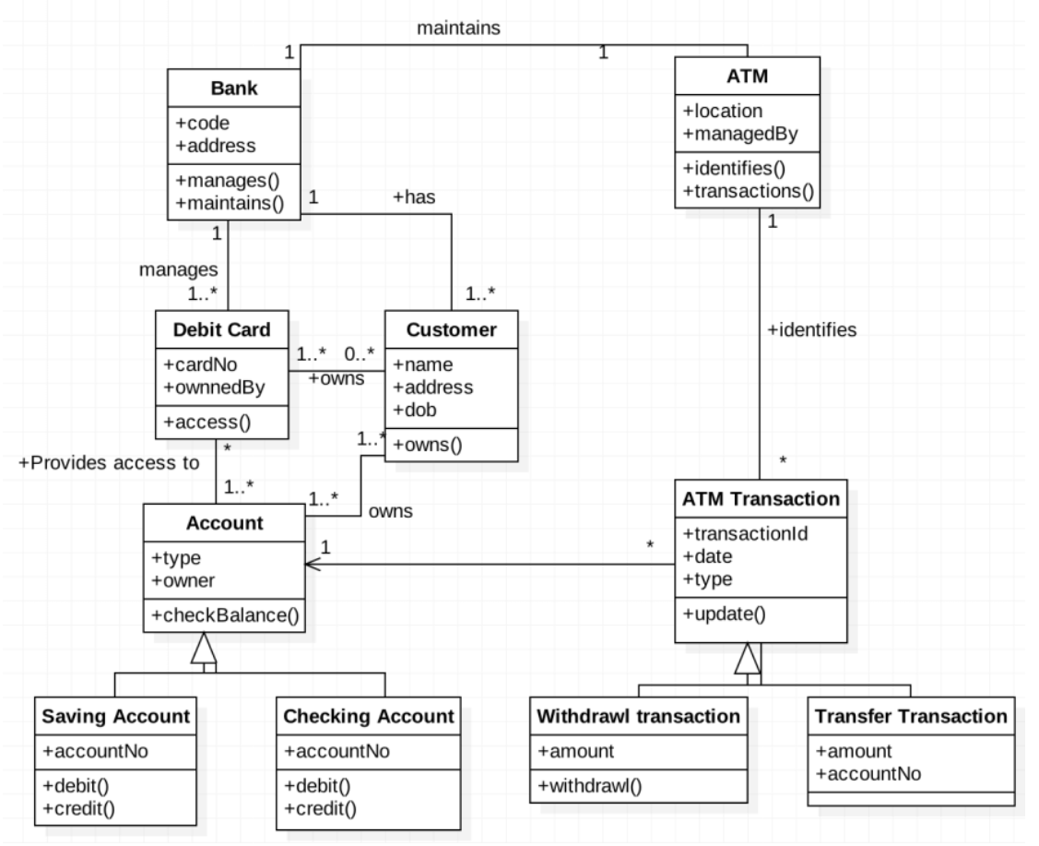
Class Diagram Example: ATM

Slide 6
Sequence Diagram
What is Sequence Diagram?
A sequence diagram is a type of interaction diagram because it describes how and in what order a group of objects works together. These diagrams are used by software developers and business professionals to understand requirements for a new system or to document an existing process. Sequence diagrams are sometimes known as event diagrams or event scenarios.

Slide 7
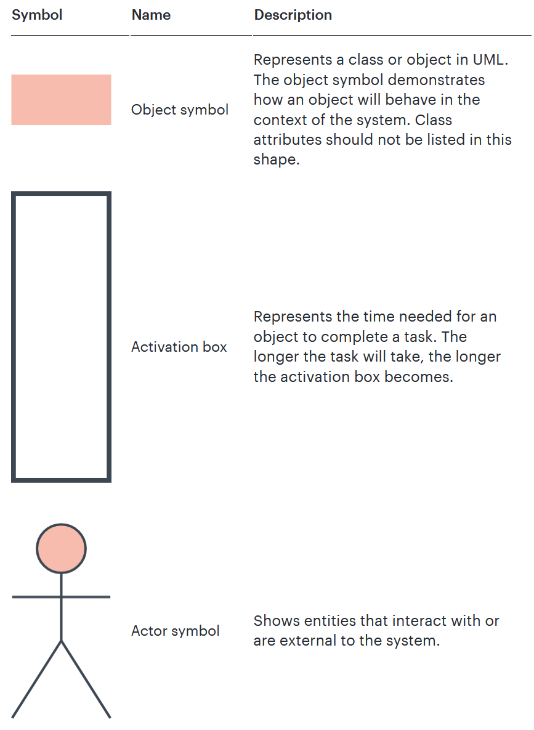
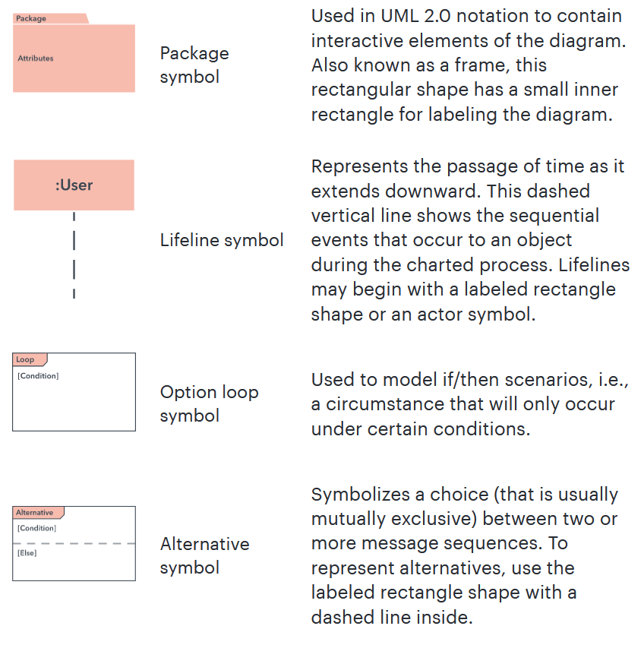
Basic Symbols and Components

Slide 8
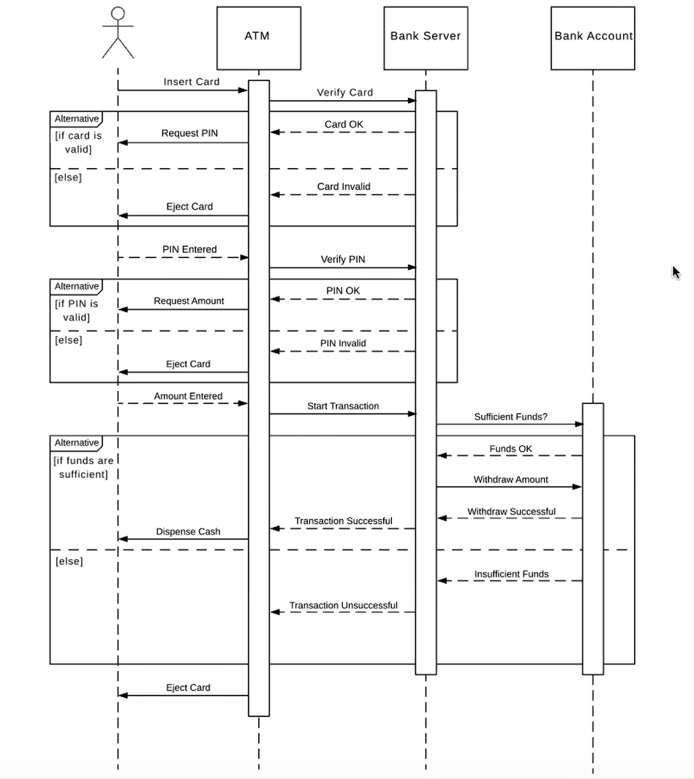
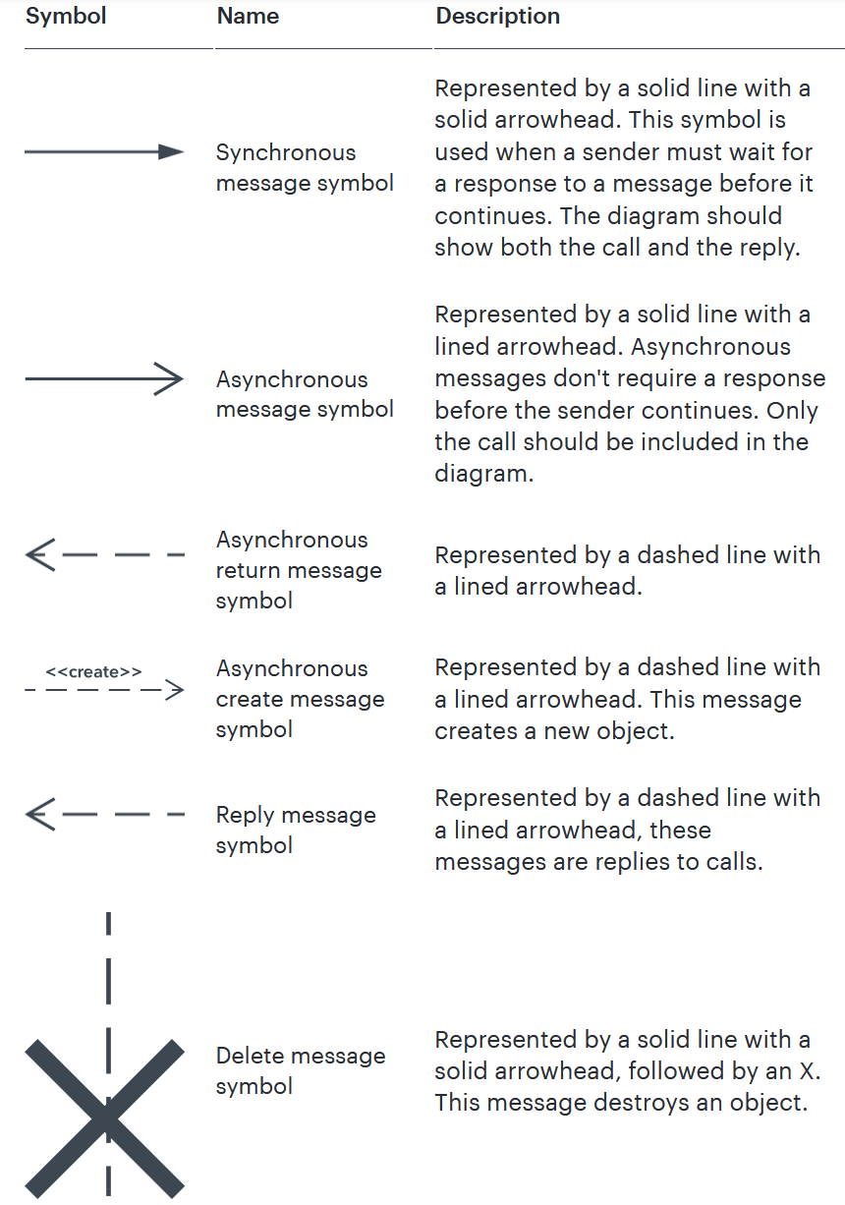
Sequence Diagram Example: ATM Transaction

